Slide 1

RTL Design Method Examples

Slide 2

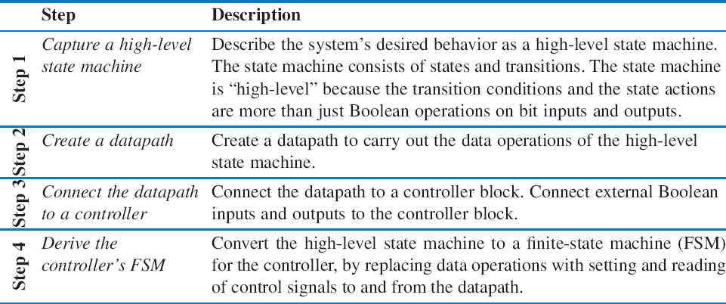
RTL Design
RTL Design Method
5.2
3

Slide 3





RTL Design
RTL Example: Video Compression – Sum of Absolute Differences
Only difference: UFO moving
Frame 1 Frame 2
Frame 1
Frame 2
Digitized
frame 1
Digitized
Digitized
Difference of
2 from 1
frame 2
frame 1
a
1 Mbyte 1 Mbyte 1 Mbyte
(b)
0.01 Mbyte
Just send
Video is a series of frames (e.g., 30 per second)
Most frames similar to previous frame
difference
□ Compression idea: just send difference from previous frame
4

Slide 4
RTL Design
RTL Example: Video Compression – Sum of Absolute Differences
compare
Frame 1
Each is a pixel, assume represented as 1 byte (actually, a color picture might have 3 bytes per pixel, for intensity of red, green, and blue components of pixel)
Frame 2
Need to quickly determine whether two frames are similar enough to just send difference for second frame
Compare corresponding 16x16 “blocks”
Treat 16x16 block as 256-byte array
Compute the absolute value of the difference of each array item
Sum those differences – if above a threshold, send complete frame for second frame; if below, can use difference method (using another technique, not described)
5

Slide 5
RTL Design
RTL Example: Video Compression – Sum of Absolute Differences
256-byte array ^{A}
SAD
integer
256-byte array ^{B}
sad
go
!(i<256)
Want fast sum-of-absolute-differences (SAD) component
□ When go=1, sums the differences of element pairs in arrays A and
B, outputs that sum
6

Slide 6

RTL Design
RTL Example: Video Compression – Sum of Absolute Differences
A
SAD
Inputs: A, B (256 byte memory); go (bit) Outputs: sad (32 bits)
Local registers: sum, sad_reg (32 bits); i (9 bits)
B
sad
go
S0
go
S1
!go
S0: wait for go
S1: initialize sum and index
S2: check if done (i>=256)
S3: add difference to sum, increment index
S4: done, write to output
sad_reg
sum = 0
i = 0
a
(i<256)’
S2
i<256
sum=sum+abs(A[i]-B[i]) i=i+1
S3
S4 sad_reg = sum
7

Slide 7

RTL Design
RTL Example: Video Compression – Sum of Absolute Differences
Step 2: Create datapath
Inputs: A, B (256 byte memory); go (bit) Outputs: sad (32 bits)
Local registers: sum, sad_reg (32 bits); i (9 bits)
AB_addr
A_data B_data
i_lt_256
<256
8 8
9
S0
go
S1
!go
i_inc
i
–
i_clr
sum = 0
i = 0
a
8
sum_ld
(i<256)’
sum
32
abs
S2
sum_clr
i<256
sum=sum+abs(A[i]-B[i])
i=i+1
32 32
8
S3
sad_reg_ld
sad_reg
+
S4 sad_reg=sum
32
Datapath
sad
8

Slide 8
RTL Design
RTL Example: Video Compression – Sum of Absolute Differences
Step 3: Connect to controller
Step 4: Replace high-level state machine by FSM
go
AB_rd
AB_addr
A_data B_data
i_lt_256
<256
S0
go’
8 8
go S1
9
i_inc
sum=0 sum_clr=1
i=0 i_clr=1
i
–
i_clr
i_lt_256’
8
S2
i<256 i_lt_256
sum=sum+abs(A[i]-B[i])
sum_ld
sum
32
abs
sum_clr
S3
sum_ld=1; AB_rd=1
i=i+1 i_inc=1
8
32 32
sad_reg_ld
S4 sad_reg=sum sad_reg_ld=1
sad_reg
+
a
Controller
32
sad
9

Slide 9
RTL Design
RTL Example: Video Compression – Sum of Absolute Differences
Comparing software and custom circuit SAD
Circuit: Two states (S2 & S3) for each i, 256 i’s→ 512 clock cycles
Software: Loop (for i = 1 to 256), but for each i, must move memory to local registers, subtract, compute absolute value, add to sum, increment i – say about 6 cycles per
array item → 256*6 = 1536 cyc les !(i<256)
Circuit is about 3 times (300%) faster
Later, we’ll see how to build SAD circuit that is even faster
(i<256)’
S2
i<256
sum=sum+abs(A[i]-B[i])
i=i+1
S3
10

Slide 10
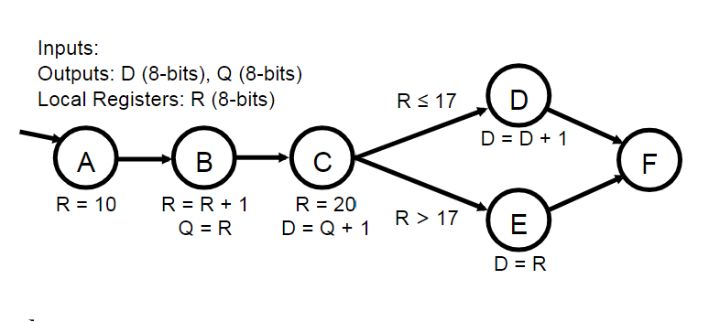
RTL Design
Pitfalls and Good Practice
Considering the high-level state machine shown to the right, what is the final value of D in state F?
1. 10
2. 11
3. 12
4. 17
5. 20
Inputs:
Outputs: D (8-bits), Q (8-bits) Local Registers: R (8-bits)
D
D = D + 1
R ≤ 17
A B
R = 10 R = R + 1 Q = R
C
R = 20 D = Q + 1
F
R > 17
E
D = R
13

Slide 11
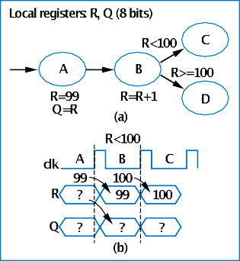
RTL Design
Pitfalls and Good Practice
Common pitfall: Assuming register is update in the state it’s written
All registers updates in each state will happen simultaneously
On the next rising clock edge
Consider the FSM to the right:
What is the final value of Q?
What is the final state?
Answer:
Value of Q unknown
Final state is C (not D)
Why?
State A: R=99 and Q=R happen simultaneously
State B: R not updated with R+1 until next clock cycle, simultaneously with state register being updated
12

Slide 12
RTL Design
Pitfalls and Good Practice
Considering the high-level state machine shown to the right, what is the final value of D in state F?
1. 10
2. 11
3. 12
4. 17
5. 20
Inputs:
Outputs: D (8-bits), Q (8-bits) Local Registers: R (8-bits)
D
D = D + 1
R ≤ 17
A B
R = 10 R = R + 1 Q = R
C
R = 20 D = Q + 1
F
R > 17
E
D = R
13

Slide 13
RTL Design
Pitfalls and Good Practice
Common pitfall: Reading outputs
Outputs should only be written
Solution: Introduce additional register, which can be written and read
Inputs: A, B (8 bits) Outputs: P (8 bits)
Inputs: A, B (8 bits) Outputs: P (8 bits) Local register: R (8 bits)
S
T
S
T
P=A
P=P+B
R=A P=A
(b)
P=R+B
(a)
14

Slide 14
RTL Design
Pitfalls and Good Practice
Good practice: Register all data outputs
In fig (a), output P would show spurious values as addition computes
Furthermore, longest register-to-register path, which determines clock period, is not known until that output is connected to another component
In fig (b), spurious outputs reduced, and longest register-to-register path is clear
B
B
R
R
+
+
P
(a)
Preg
P
(b)
15

